Slide 1
ca-505:project Fitness guide helps in maintaining a healthy lifestyle
Presented by:
17.Shubhashree Bhosale
47.Vaibhavi kadu

Slide 2
introduction The fitness guide is a web-based application designed to help users maintain a healthy lifestyle by providing features like workout plans, diet suggestions, calorie calculators, habit tracking, and fitness challenges. Built using html, css, and bootstrap for the frontend, and python (flask) with sqlite for the backend, this system ensures a simple yet powerful platform for fitness management. The primary goal of this system is to assist users in tracking their daily health activities through an intuitive dashboard and user-friendly interface.

Slide 3
Problem statement In today’s busy lifestyle, people often struggle to maintain their fitness and healthdueto: • lack of awareness: many individuals do not know the right workout plans or diet routines for their body type. • Inconsistent tracking: manually tracking calories, workouts, and habits often leads to irregularity and loss of motivation. • Time constraints: visiting gyms or consulting dieticians regularly may not be feasible for everyone. • Data fragmentation: fitness-related information is scattered across different apps or sources, making it inconvenient for users. • Lack of personalization: generalized plans may not be effective for every individual. To overcome these challenges, the fitness guide system is developed as a digital solution that provides a centralized platform to manage workouts, diets, calorie intake, habits, and challenges, ensuring efficiency, accessibility, and motivation for users.

Slide 4
Purpose/objectives • The fitness guide aims to digitize and streamline fitness management, reducing manual effort and inconsistency. • It provides a centralized platform for handling workouts, diet plans, calorie tracking, and habit monitoring. • The system enhances efficiency, accessibility, and motivation, ensuring smooth health and fitness tracking for users

Slide 5
goals
Automate Fitness Tracking – Reduce manual effort in managing workouts and diets.
Enhance Data Accessibility – Provide secure and quick access to fitness records. Simplify
Calorie & Habit Monitoring – Ensure accurate tracking and updates. Improve User
Motivation – Encourage regular workouts and healthy habits. Ensure Data Security –
Protect user health and fitness information. Provide a User-Friendly Interface – Offer a clean, modern, and easy-to-use system.

Slide 6
scope
The Fitness Guide is designed to streamline fitness management by digitizing processes such as workout planning, diet tracking, calorie calculation, habit monitoring, and fitness challenges. It provides a centralized, user-friendly dashboard for users to manage their health and fitness goals efficiently.

Slide 7
LIMITATIONS
• The system is limited to basic workout and diet features, lacks personalized AI-based recommendations, and requires an internet connection for access.
• It focuses on core health tracking functionality over advanced UI/UX or wearable device integration, and is intended for individual use rather than multi-user organizations.

Slide 8
SYSTEM ANALYSIS
Existing System:
• Manual Tracking – Fitness activities like diet, workouts, and calories are noted manually or remembered, leading to irregularities.
• Data Inconsistency – High chances of errors or missing records due to lack of proper tracking tools.
• Time-Consuming – Monitoring calories, workouts, and habits manually takes significant time and effort.
• Limited Accessibility – Fitness information is scattered and not available in one centralized platform.

Slide 9
PROJECT PERSPECTIVE , FEATURES
Project Perspective: Develop a web-based Fitness Guide System for managing workouts, diet, and healthy habits.
Features: User registration and login , Workout plans , guidance , Calorie calculator , Habit tracking, Fitness challenges, Simple

Slide 10
stakeholders:
Users: Registered individuals who access workouts, diet plans, calorie calculator, and challenges
Developers: Build, maintain, and improve the fitness guide system
Health & Fitness Community: Benefits from the platform as a tool to promote fitness awareness and healthy living.

Slide 11
Functional requirement
User Authentication – Secure login and registration system for users.
Workout Management – Add, view, and follow workout routines.
Diet Plans– Provide and update nutrition and meal guidance.
Calorie Calculator– Calculate and track daily calorie intake.
Habit Tracking– Record and monitor healthy lifestyle habits.

Slide 12
Non-functional requirement
Performance– The system should load pages and process requests quickly without noticeable delays.
Usability– Simple and user-friendly interface for easy navigation.
Security – Protect user data with authentication and prevent unauthorized access.
Scalability– Able to handle multiple users simultaneously without issues.
Reliability– Ensure consistent availability with minimal downtime.

Slide 13
System design
1.Data Dictionary : USER TABLE
Field-name | Data-type | Constraint | Description | Table name
User_id | INT | Unique key | Unique user_id | User
Email | VARCHAR(50) | Unique key | User email_id | User
Password | VARCHAR(50) | Not null | User password | User
username | VARCHAR(50) | Not null | Display user’s name | User

Slide 14
TABLE DESIGN
2.User table
Field-name | Data-type | Constraint
User_id | INT | Primary key
Email | VARCHAR(50) | Unique key
Password | VARCHAR(25) | Not null
username | VARCHAR(50) | Not null

Slide 15
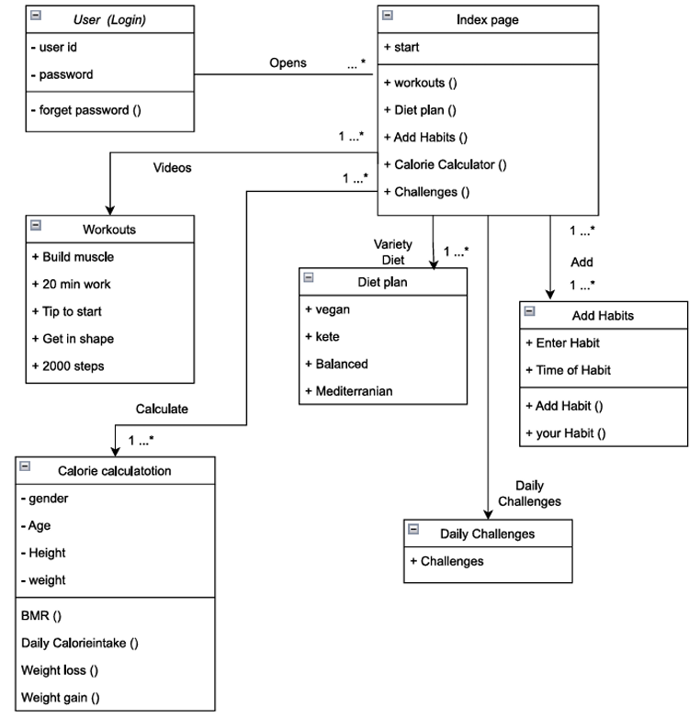
3.System model Class diagram

Slide 16
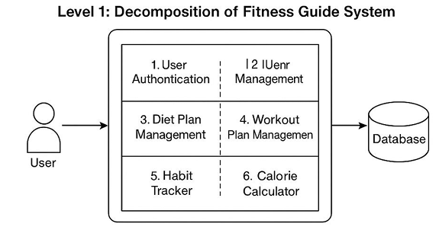
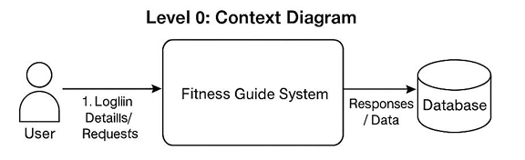
Dfd

Slide 17
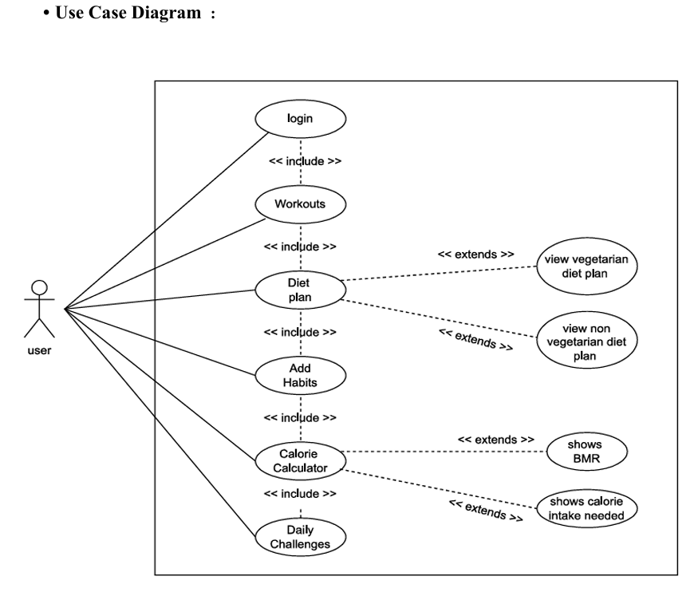

Slide 18
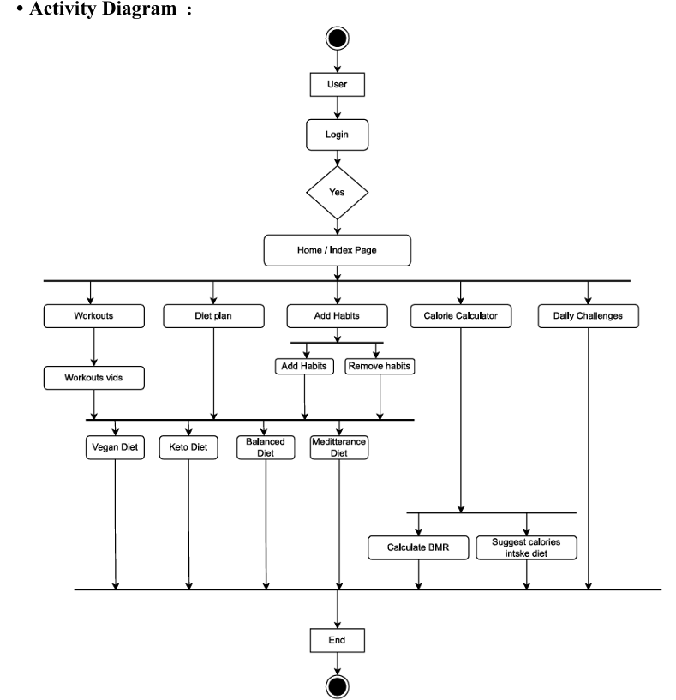

Slide 19
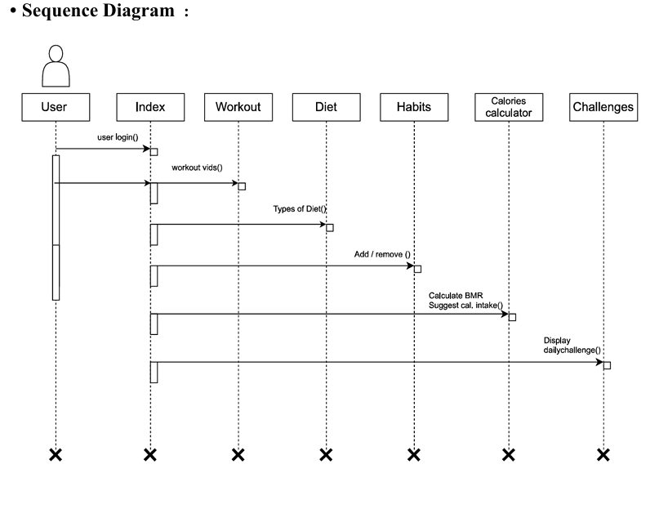

Slide 20
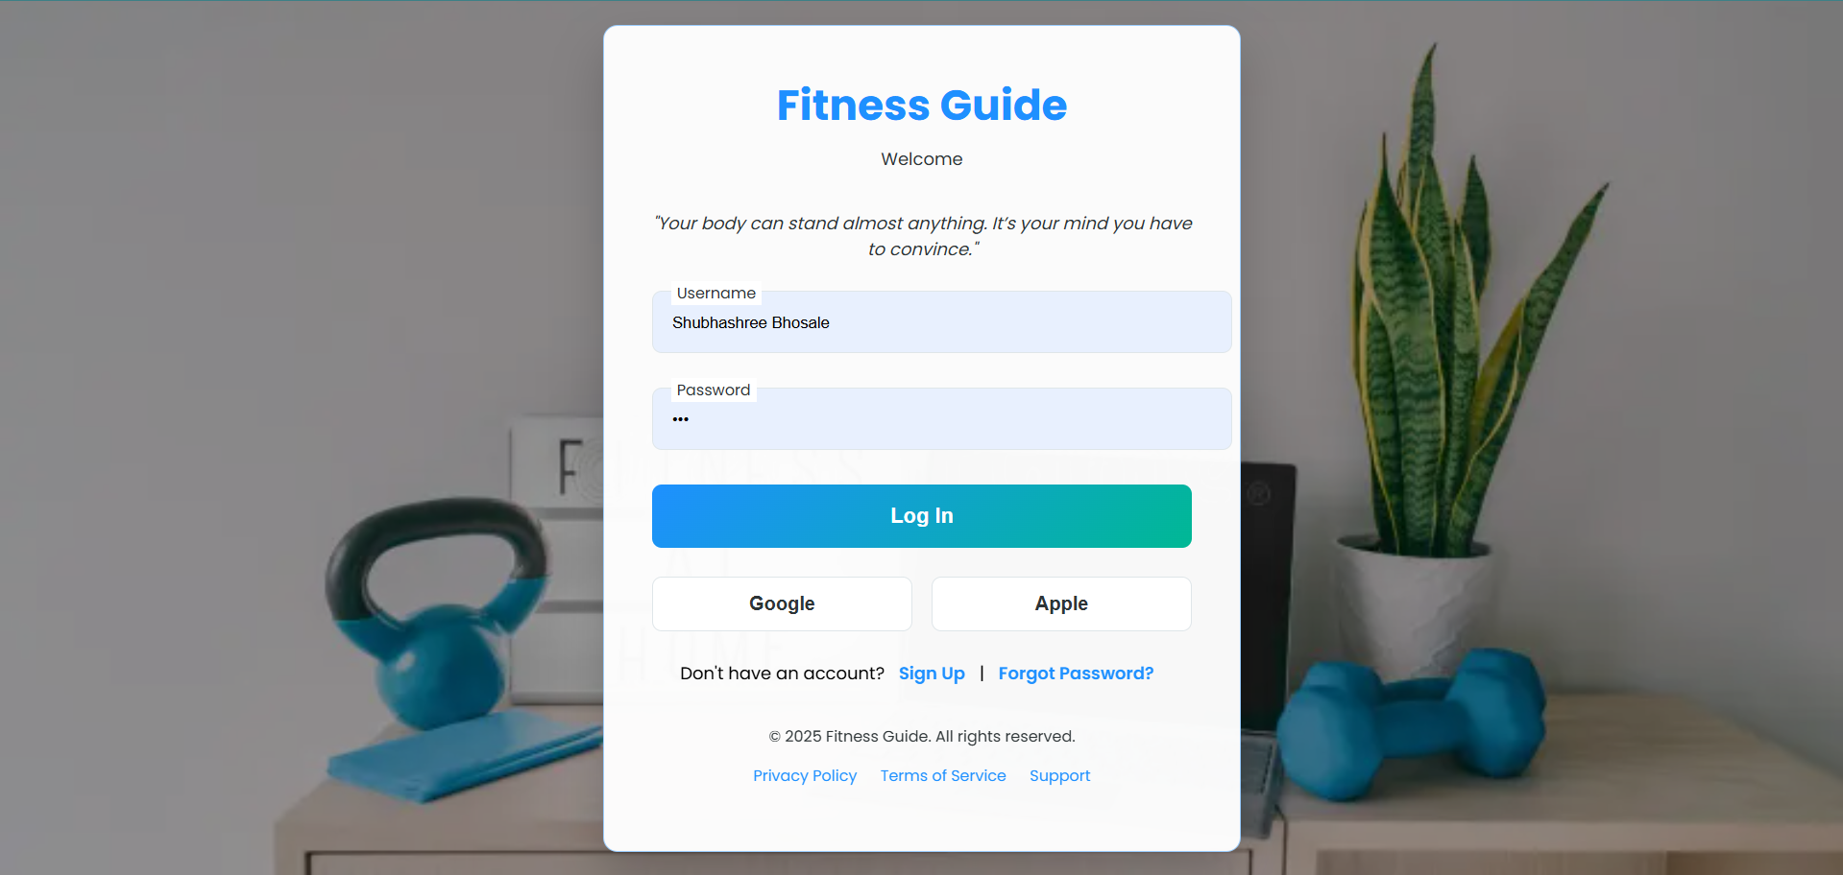
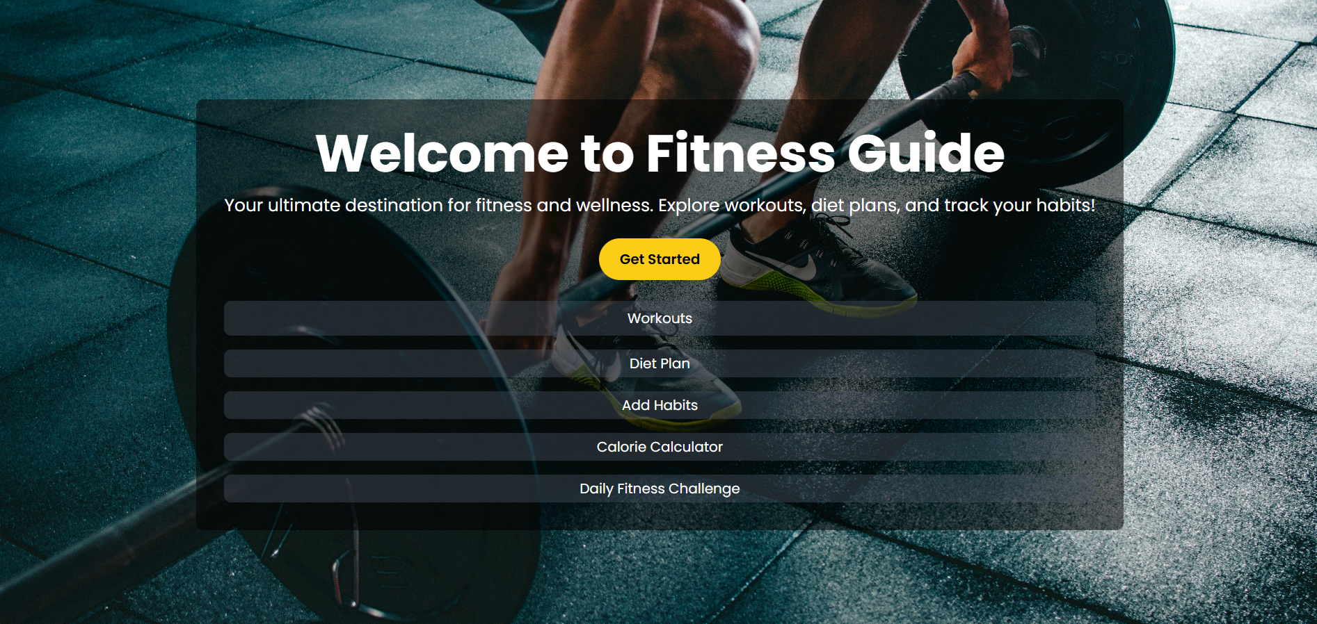
User interface
Input screen: login page
Home page

Slide 21
Implementation Details Hardware Requirements:
● Minimum RAM: -256 MB
● Hard Disk: -40 GB
● Processor: - 12th Gen Intel(R) Core(TM) i5-12450H 2.00 GHz
● System type:- 64-bit operating system, x64-based processor
Internet Access Software Requirements:
● Visual Studio Code
● Suitable Web Browser
● Python (Flask Framework)
● SQLite Database

Slide 22
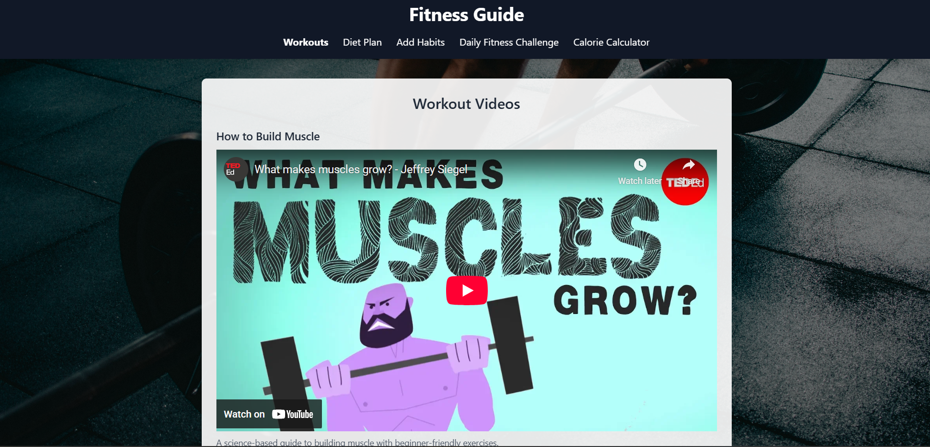
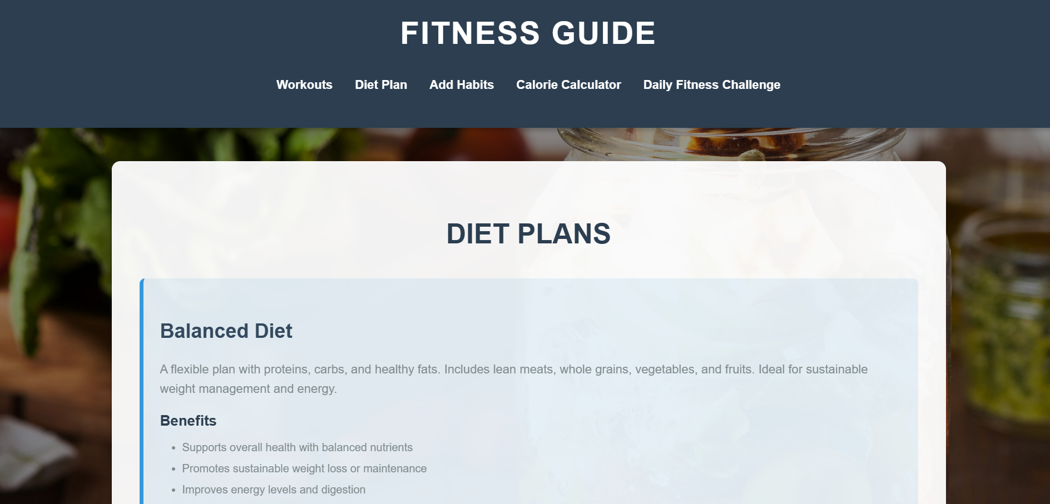
Outputs and report testing :

Slide 23
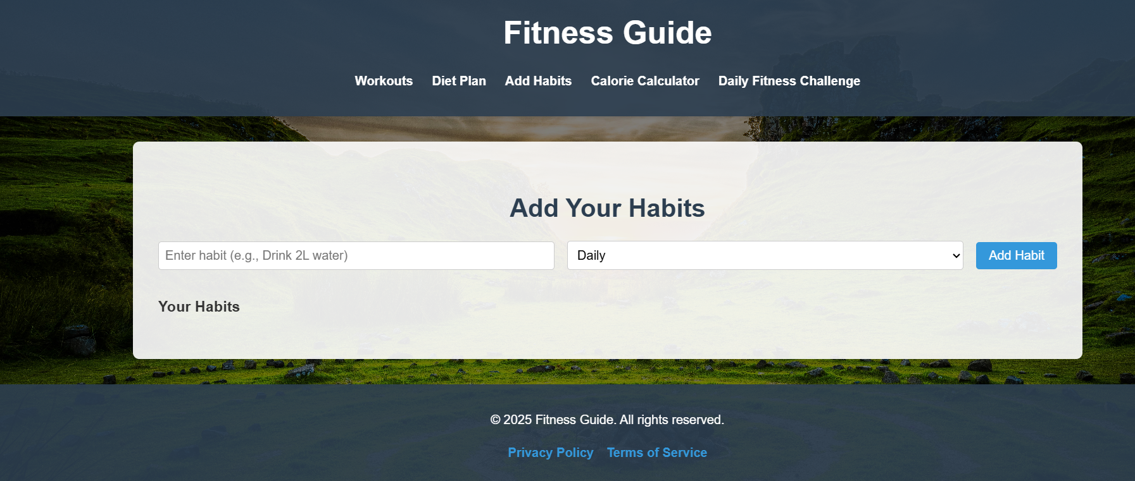
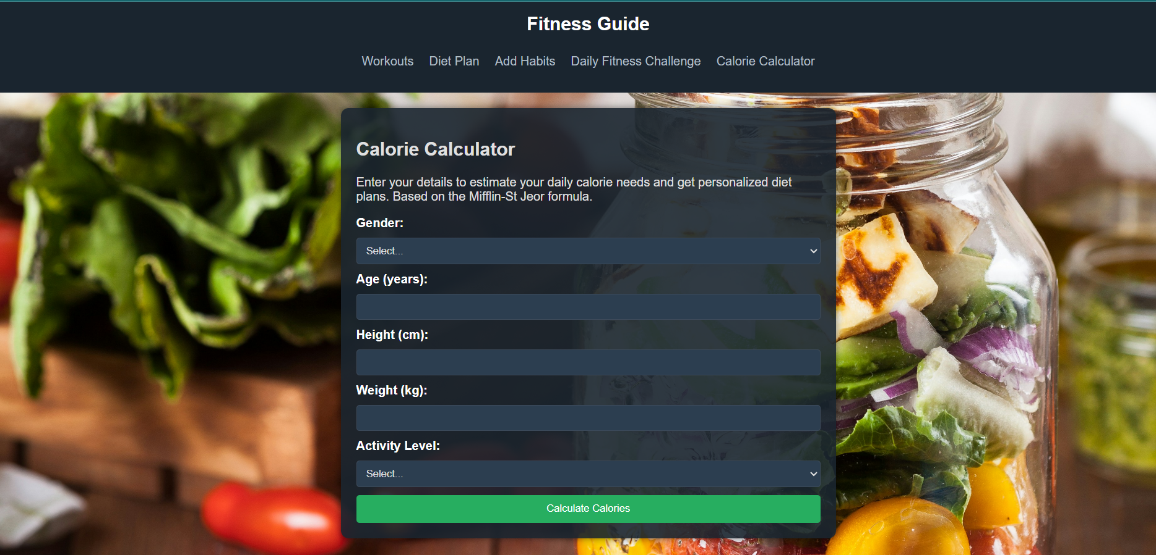
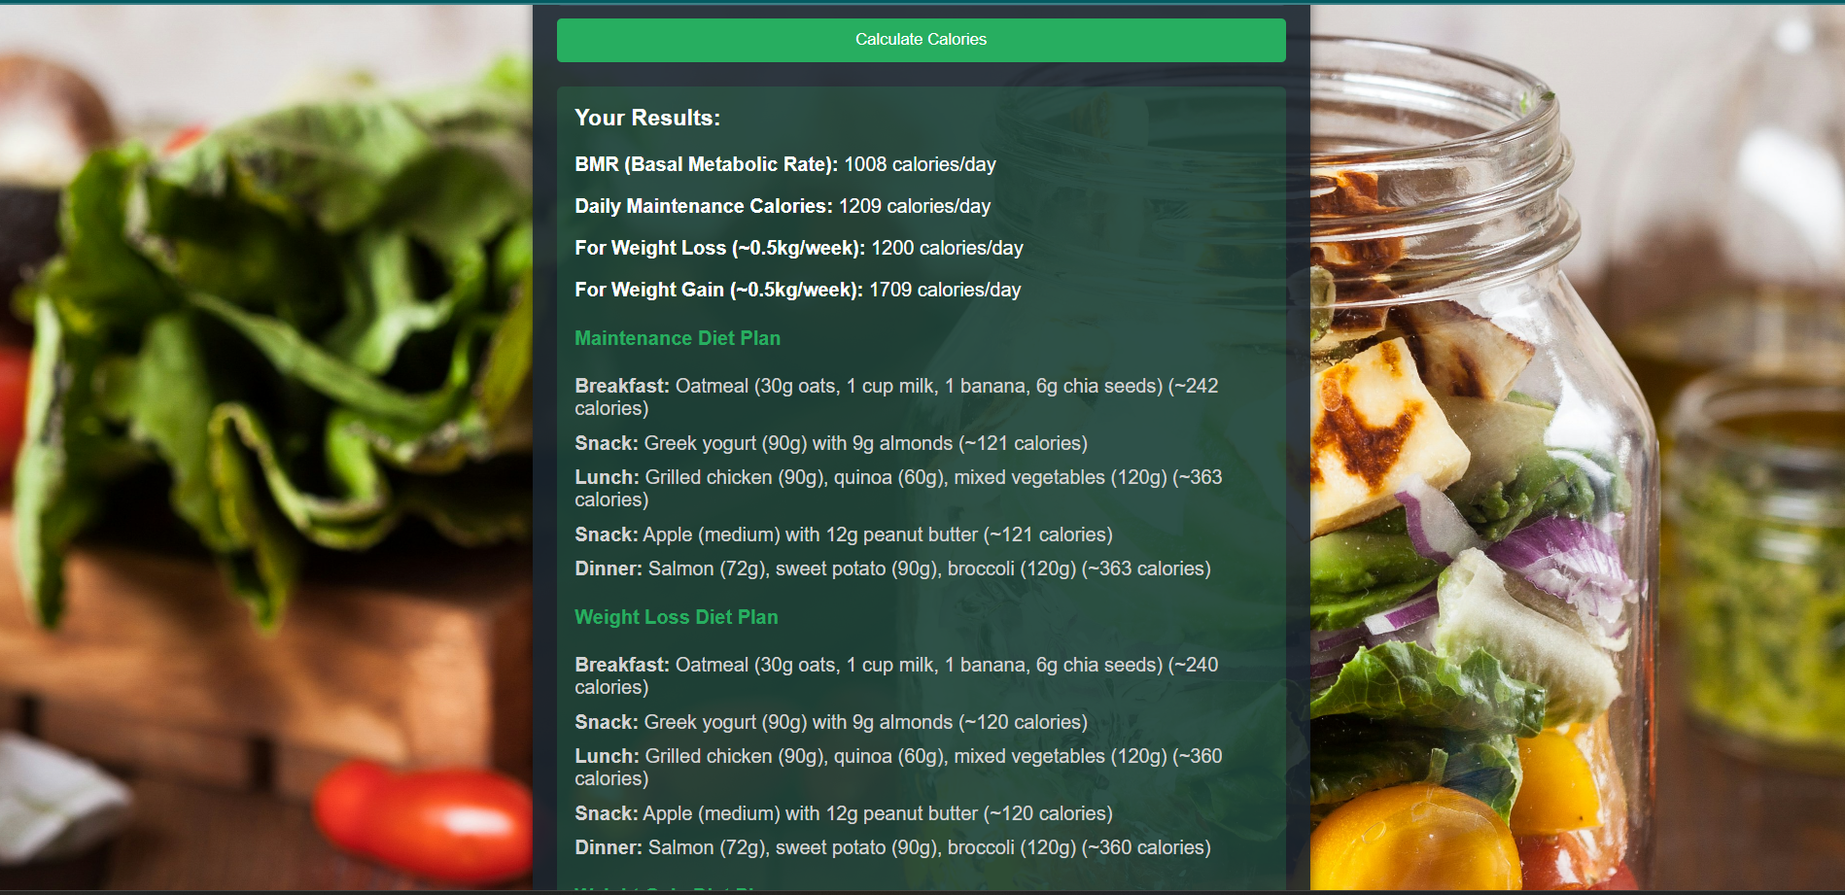
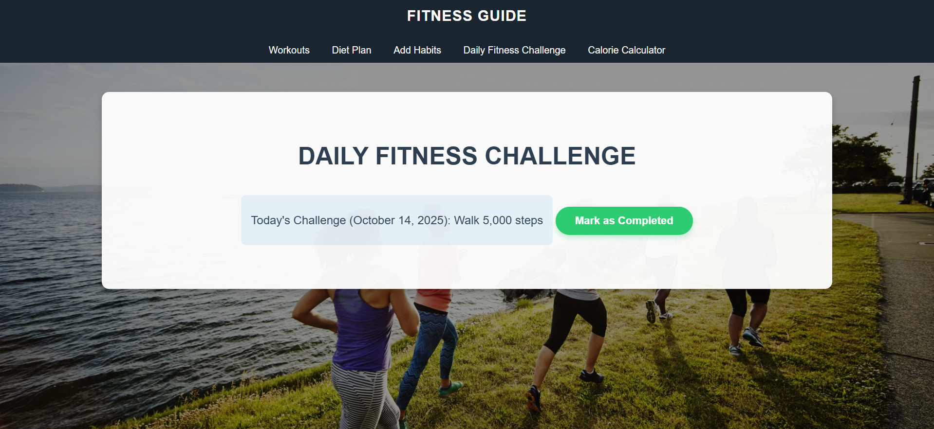

Slide 24
Test Plan
Functional Testing Output
• User Authentication: Login and Signup modules function correctly. Users can securely register, log in, and access their fitness dashboard.
• Workout Plans: All workout routines are displayed accurately with proper categories such as Beginner, Intermediate, and Advanced.
• Diet Plan Management: Diet plans load properly based on user preferences (vegetarian/non-vegetarian) and display correct meal details.
• Calorie Calculator: The calculator accurately computes daily calorie requirements based on user input (age, gender, weight, and activity level).
• Progress Tracking: Users can successfully record and update their fitness progress, including weight, steps, and workout history.
2. Performance Testing Output
• Speed & Load Time: The web application loads quickly, and navigation between pages is smooth, even under multiple user sessions.
• Database Performance: The database efficiently stores and retrieves user data, diet charts, and workout records without delays.
• API Response Time: All backend API responses are processed within acceptable limits, ensuring seamless communication between frontend and backend.

Slide 25
3. Security Testing Output
• User Data Protection: User credentials and personal health information are securely stored using encrypted authentication methods.
• Session Security: Sessions are properly managed to prevent unauthorized access after logout or idle time.
• Form Validation: All forms (login, registration, calorie calculator) validate user inputs to prevent invalid or harmful entries.
4. Compatibility Testing Output
• Cross-Browser Compatibility: The web app runs smoothly on major browsers like Google Chrome, Mozilla Firefox, and Microsoft Edge.
• Device Responsiveness: The interface adapts properly on desktops, laptops, and tablets, maintaining usability and readability.
• Operating System Support: The application performs consistently on Windows, macOS, and Android (via browsers).

Slide 26
Recommendations:
• Regular Updates: Continuously improve the system by adding new workouts, diets, and features based on user feedback and fitness trends.
• Security Improvements: Implement multi-factor authentication and encrypt user data to enhance safety.
• Mobile Compatibility: Develop a mobile app version to increase accessibility and user engagement.
• AI Integration: Use artificial intelligence for personalized fitness and diet recommendations.
• Progress Tracking: Add detailed progress graphs and achievement badges to motivate users.
• Integration with Devices: Connect with wearable fitness trackers and smartwatches for real time activity monitoring.

Slide 27
Future Scope :
System Scalability & Market Expansion: • With a strong technical foundation, the Fitness Guide Web Application can be scaled for larger audiences, including gyms, fitness clubs, and corporate wellness programs.
2. Technological Advancements: • Integrate Artificial Intelligence (AI) and Machine Learning (ML) for personalized workout and diet recommendations based on user history and goals..
3. Cloud Integration & Remote Accessibility: • Shift to a cloud-based architecture to improve scalability, enhance data security, and allow users to access their profiles from anywhere.
4. Global Reach & Localization: • Adapt the platform for international use with multi-language support and regional customization for dietary and workout preferences.
Bibliography and References
1.Bibliography
https://flask.palletsprojects.com/
https://www.w3schools.com/
https://developer.mozilla.org/
2.Referances
https://www.healthline.com/
https://www.bodybuilding.com/
https://www.geeksforgeeks.org/
https://www.sqlite.org/

